Slide 1
3D Computer Vision
Dr. Hassan Foroosh
School of EECS
UCF

Slide 2
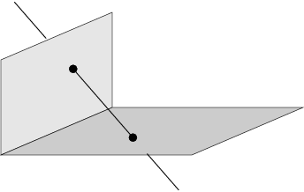
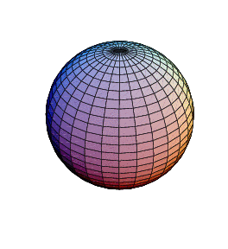
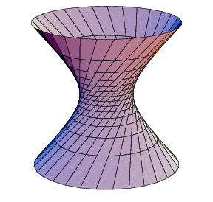
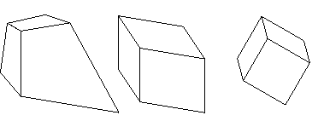
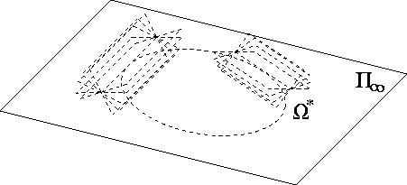
Last Lectures:
3D Projective Geometry
Points, lines, planes and quadrics
Transformations
П∞, ω∞ and Ω ∞

Slide 3
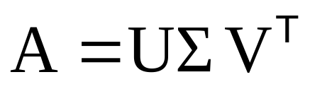




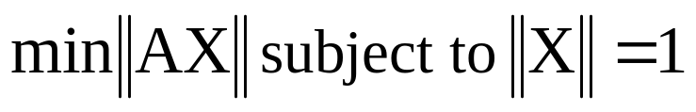
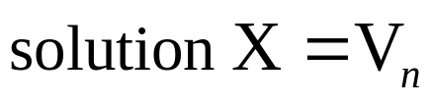
Singular Value Decomposition
Homogeneous least-squares

Slide 4
Estimation
2D homography
  Given a set of (x_{i},x_{i}’), compute H (x_{i}’=Hx_{i})
3D to 2D camera projection
  Given a set of (X_{i},x_{i}), compute P (x_{i}=PX_{i})
Fundamental matrix
  Given a set of (x_{i},x_{i}’), compute F (x_{i}’^{T}Fx_{i}=0)
Trifocal tensor
  Given a set of (x_{i},x_{i}’,x_{i}”), compute T

Slide 5
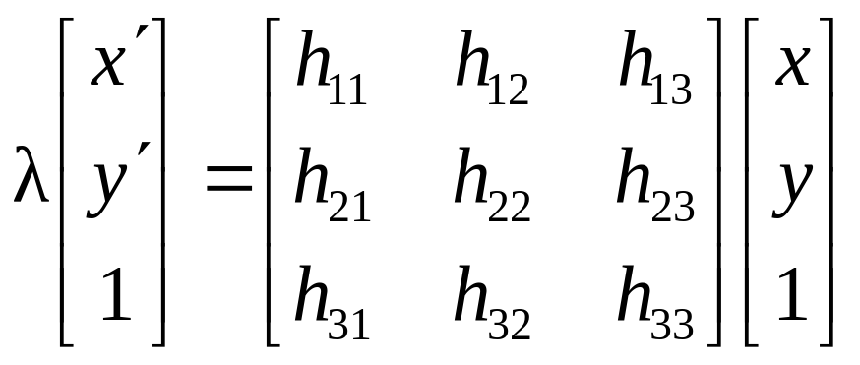
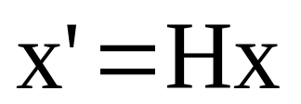
Number of measurements required
At least as many independent equations as the degrees of freedom
Example:
2 independent equations / point
8 degrees of freedom
4x2≥8

Slide 6
Approximate solutions
Minimal solution
  4 points yield an exact solution for H
More points
  No exact solution, because measurements are inexact (“noisy”)
  Search for “best” solution according to some criterion
  Algebraic or geometric/statistical cost
Notes:
Exact solutions are important for robust approaches

Slide 7
Gold Standard algorithm
Cost function that is optimal for some assumptions
Computational algorithm that minimizes it is called “Gold Standard” algorithm
Other algorithms can then be compared to it
Notes:
Other algorithms can have other advantages: faster, more reliable, etc.

Slide 8
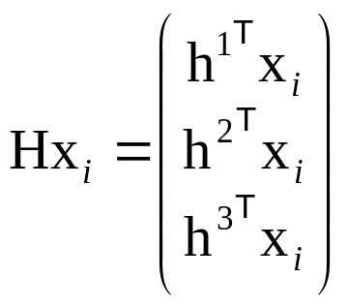
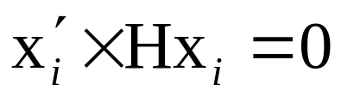
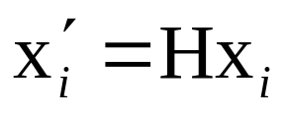
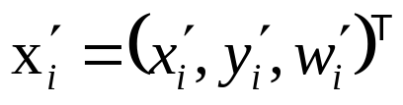
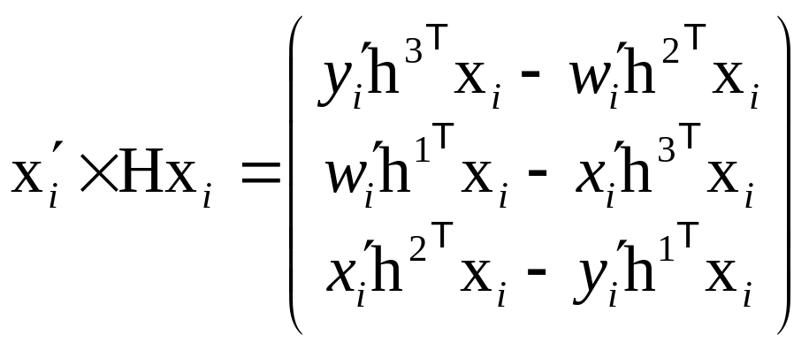
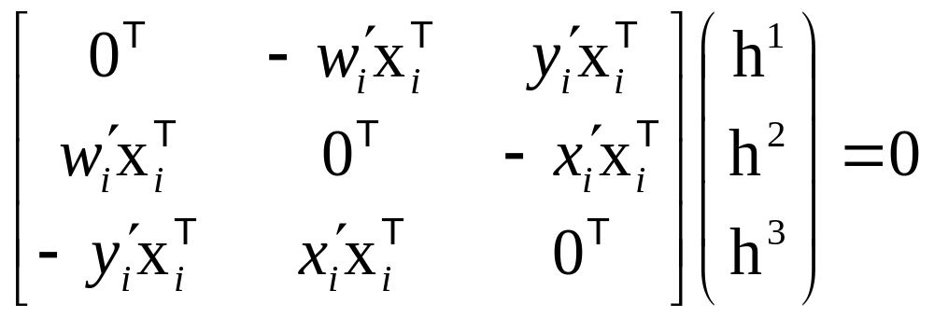
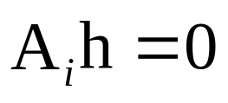
Direct Linear Transformation (DLT)

Slide 9
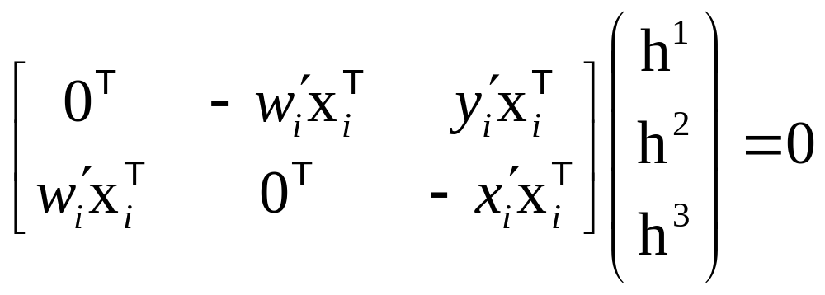
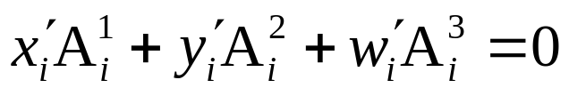
Direct Linear Transformation (DLT)
Equations are linear in h
Only 2 out of 3 are linearly independent
(indeed, 2 eq/pt)
(only drop third row if w_{i}’≠0)
Holds for any homogeneous representation, e.g. (x_{i}’,y_{i}’,1)
Notes:
row 3 = x.(row 1)+y.(row 2)

Slide 10
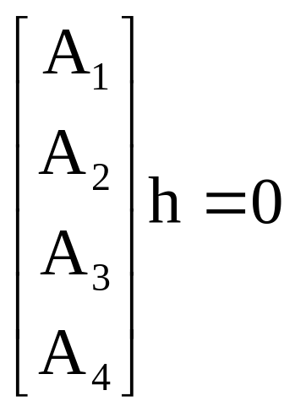

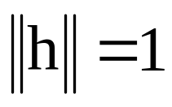
Direct Linear Transformation (DLT)
Solving for H
size A is 8x9 or 12x9, but rank 8
Trivial solution is h=0₉^{T} is not interesting
1-D null-space yields solution of interest
pick for example the one with

Slide 11
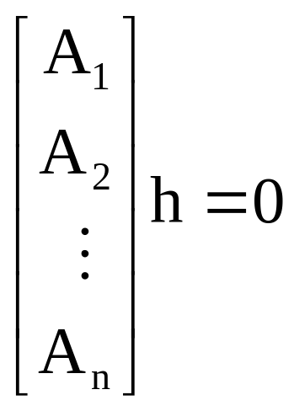


Direct Linear Transformation (DLT)
Over-determined solution
No exact solution because of inexact measurement
i.e. “noise”
Find approximate solution
Additional constraint needed to avoid 0, e.g.
not possible, so minimize

Slide 12
DLT algorithm
Objective
Given n≥4 2D to 2D point correspondences {x_{i}↔x_{i}’}, determine the 2D homography matrix H such that x_{i}’=Hx_{i}
Algorithm
For each correspondence x_{i} ↔x_{i}’ compute A_{i}. Usually only two first rows needed.
Assemble n 2x9 matrices A_{i} into a single 2nx9 matrix A
Obtain SVD of A. Solution for h is last column of V
Determine H from h

Slide 13

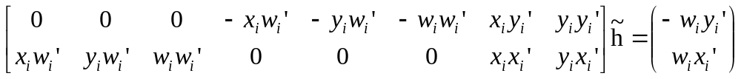
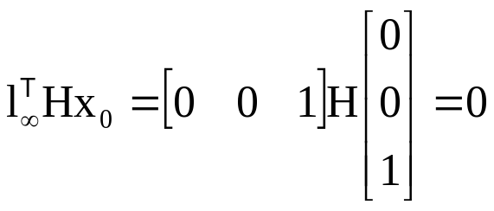
Inhomogeneous solution
Since h can only be computed up to scale, pick h_{j}=1, e.g. h₉=1, and solve for 8-vector
Solve using Gaussian elimination (4 points) or using linear least-squares (more than 4 points)
However, if h₉=0 this approach fails
also poor results if h₉ close to zero
Therefore, not recommended
Note h₉=H₃₃=0 if origin is mapped to infinity

Slide 14




Degenerate configurations
x₁
x₁
x₁
x₄
x₄
x₂
H?
H’?
x₄
x₂
x₂
x₃
x₃
x₃
(case A)
(case B)
Constraints:
i=1,2,3,4
Define:
Then,
H* is rank-1 matrix and thus not a homography
If H* is unique solution, then no homography mapping x_{i}→x_{i}’(case B)
If further solution H exist, then also αH*+βH (case A)
(2-D null-space instead of 1-D null-space)

Slide 15
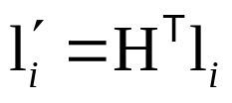


Solutions from lines, etc.
2D homographies from 2D lines
Minimum of 4 lines
3D Homographies (15 dof)
Minimum of 5 points or 5 planes
2D affinities (6 dof)
Minimum of 3 points or lines
Conic provides 5 constraints
Mixed configurations?

